Slide 1
The What, Why, and How of a University Makerspace
Dan Hillis
Library Systems and Makerspace Coordinator
University of Wisconsin-Eau Claire

Slide 2
What is a makerspace?
Space
Tools
Expertise
Community
Varies widely based on Budget, Staff, Demand

Slide 3
What is a makerspace?
Other names:
Fablab
Hackerspace
Communities
Maker Movement (think Mythbusters)
Pinterest

Slide 4
Sample uses
3D scanner and 3D printer for medical and physical therapy uses
3D printer and laser cutter for art
Build a remote control car to learn electronics

Slide 5
Why should a university have a makerspace?
For Students
Develop skills
State-of-the-art technologies
Personal and class projects
Community
Entrepreneurs and startups

Slide 6
Why should a university have a makerspace?
For Campus
Stories of innovation
Stay competitive
Increase retention

Slide 7
How did we implement the Blugold Makerspace?
2016
2016
2017
2017
2017
2018
2018
2018
2018
July – Start researching and gathering data
August – Pitch to director
February – Exploration committee
October – Meet with campus faculty
December – Pitch to ITC and SOS
March – Both ITC and SOS provided funding
May – Start purchasing
July – Renovation of space
September – Grand opening

Slide 8
Makerspace exploration committee
Support from faculty?
Demand from students?
Scope of equipment?
Create marketing pamphlet
Create proposal/budget

Slide 9
Funding Sources
ITC – Information Technology Commission
SOS – Student Office of Sustainability
UW-Eau Claire Foundation – Crowdfunding campaign

Slide 10
Makerspace implementation committee
Mission/Vision/Values/Goals
Hours
Staffing
Funding
Policies
Student organization
Safety
Name
Books/magazines
Purchase the equipment/materials
Schedule the facilities work
Marketing and advertising

Slide 11
Blugold Makerspace - Waivers for everyone

Slide 12
Blugold Makerspace - Budget
$1,000.00 Hand tools
$700.00 Small power tools
$800.00 Legos
$2,300.00 3D printers and filament
$4,000.00 Computers and Wacom
$800.00 Fabrics
$700.00 Crafting
$2,500.00 Electronics
$400.00 Storage
$10,000.00 Space renovation
$2,000.00 TV and Document Camera

Slide 13
Blugold Makerspace – Hours/Staff
 | Sunday | Monday | Tuesday | Wednesday | Thursday | Friday | Saturday
8:00am
9:00am
10:00am
11:00am
 |  |  | Open | Open | Open
12:00pm
 |  | Open | Open | Open | Open | Open
1:00pm
 |  | Open | Open | Open | Open | Open
2:00pm
 |  | Open | Open | Open | Open | Open
3:00pm
 |  | Open | Open | Open | Open
4:00pm
 |  | Open | Open | Open | Open
5:00pm
 |  | Open | Open | Open | Open
6:00pm
 |  |  |  | Open
7:00pm
 |  |  |  | Open
8:00pm
9:00pm
10:00pm
STAFFING
7 Library staff
1 Outside staff
3 Students

Slide 14
Blugold Makerspace – Faculty interest
French – Sewing reusable bags and describing the experience in French
Music history – Soldering radio kits as group projects
Education majors – Touring the makerspace before graduating
Board game design – 3D printing and crafts for prototyping
Bag It Fashion Show – Reusing materials and garment fabrication

Slide 15
Usage Statistics

Slide 16
Workshops

Slide 17
Blugold Makerspace – What didn’t work
Generic Student Organization
Generic / Lesson-style workshop
And now, “Pictures or it didn’t happen!”

Slide 18
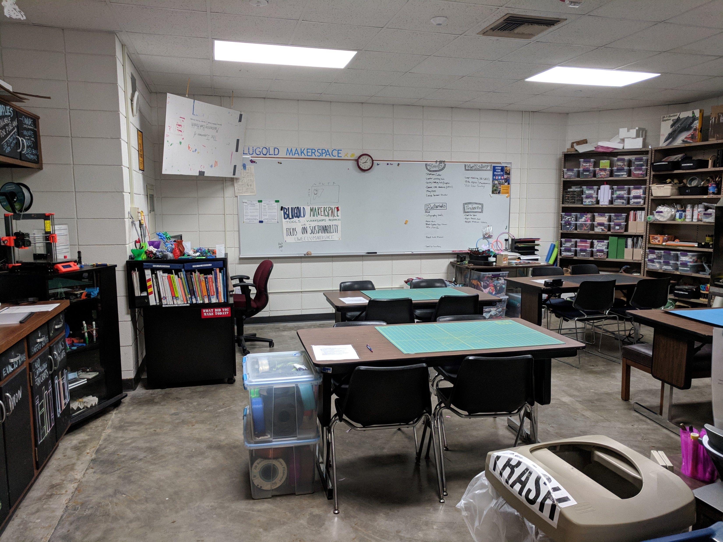

Slide 19
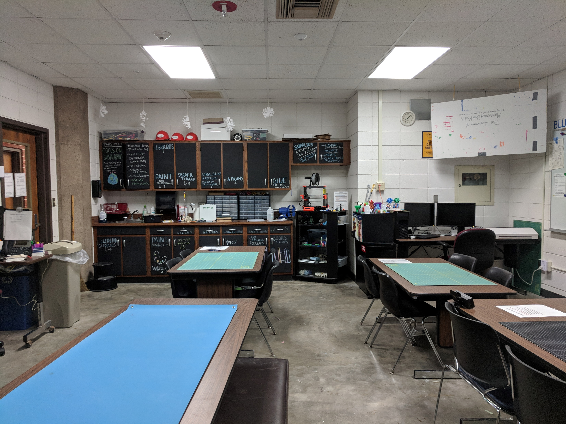

Slide 20
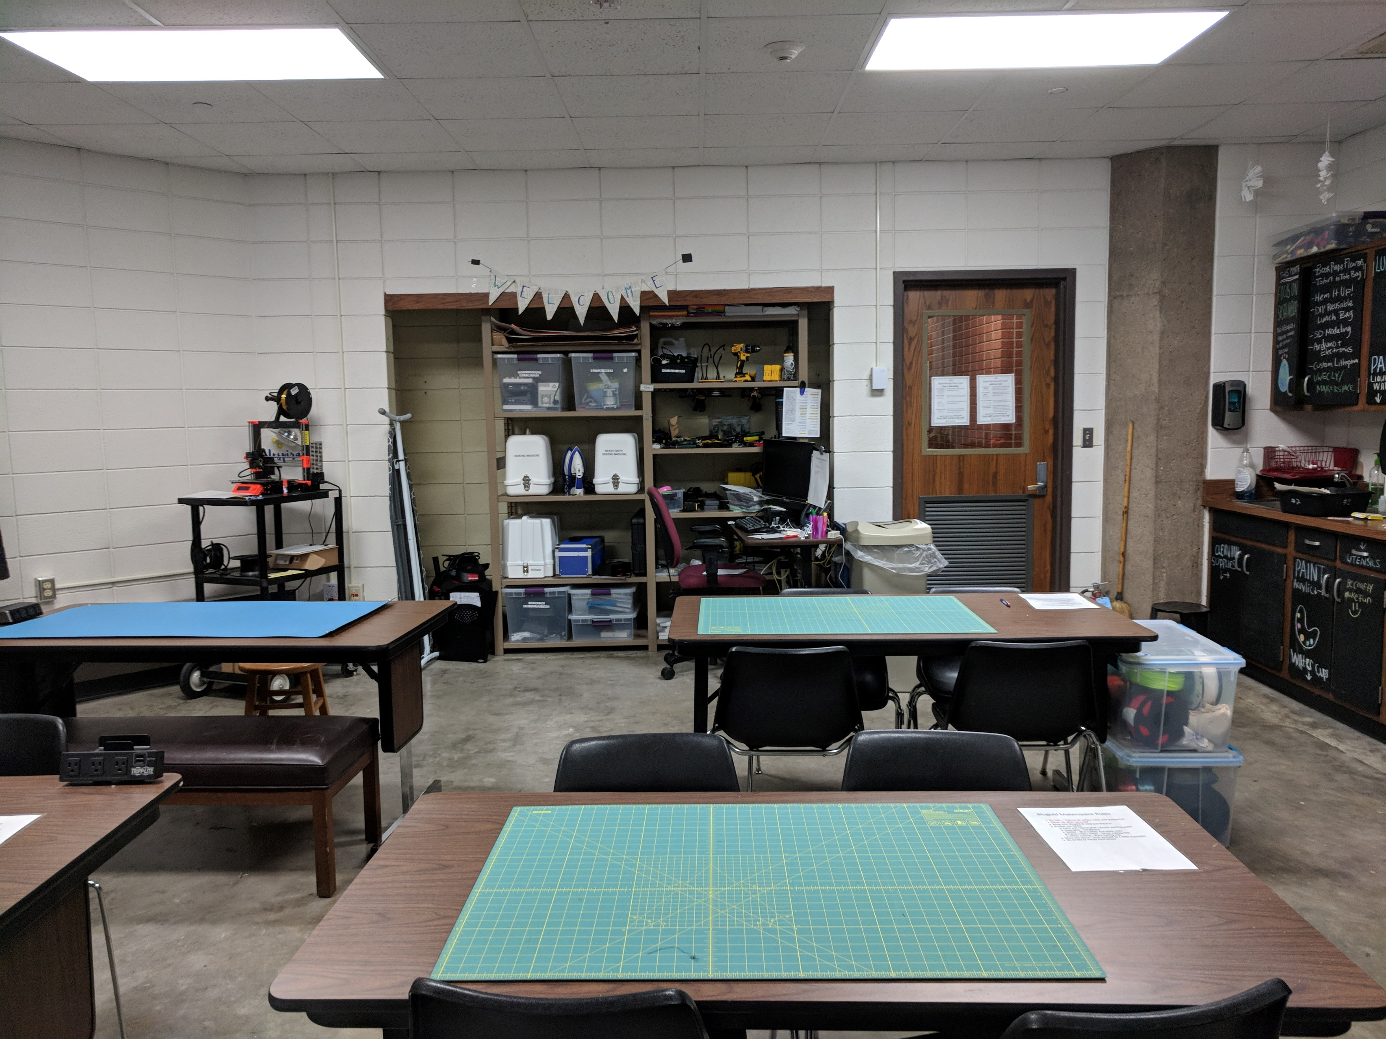

Slide 21
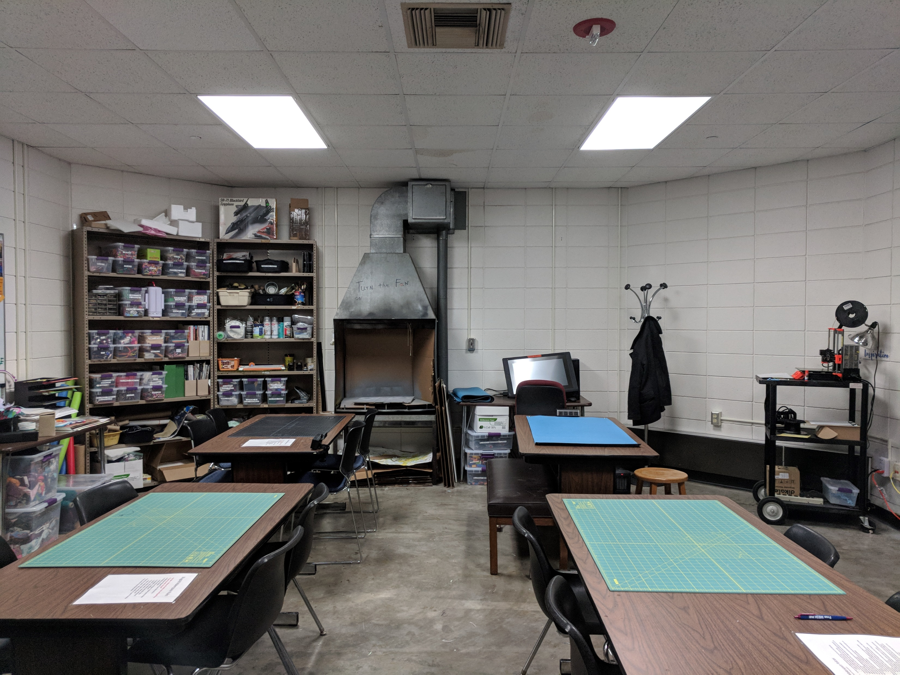

Slide 22
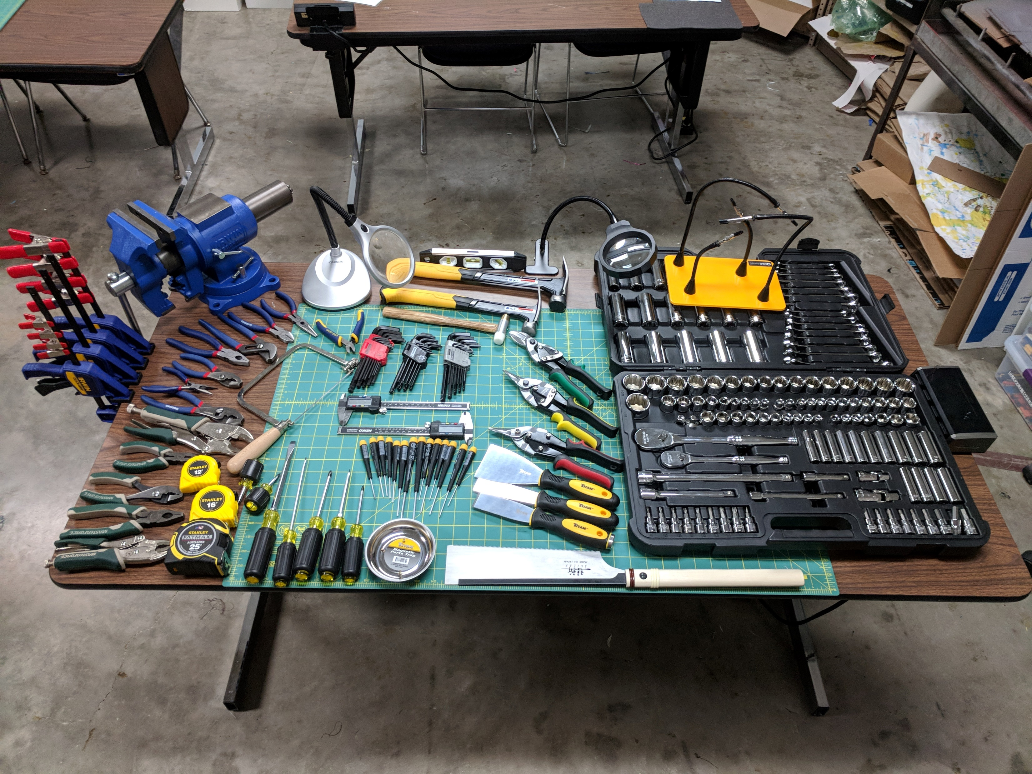

Slide 23
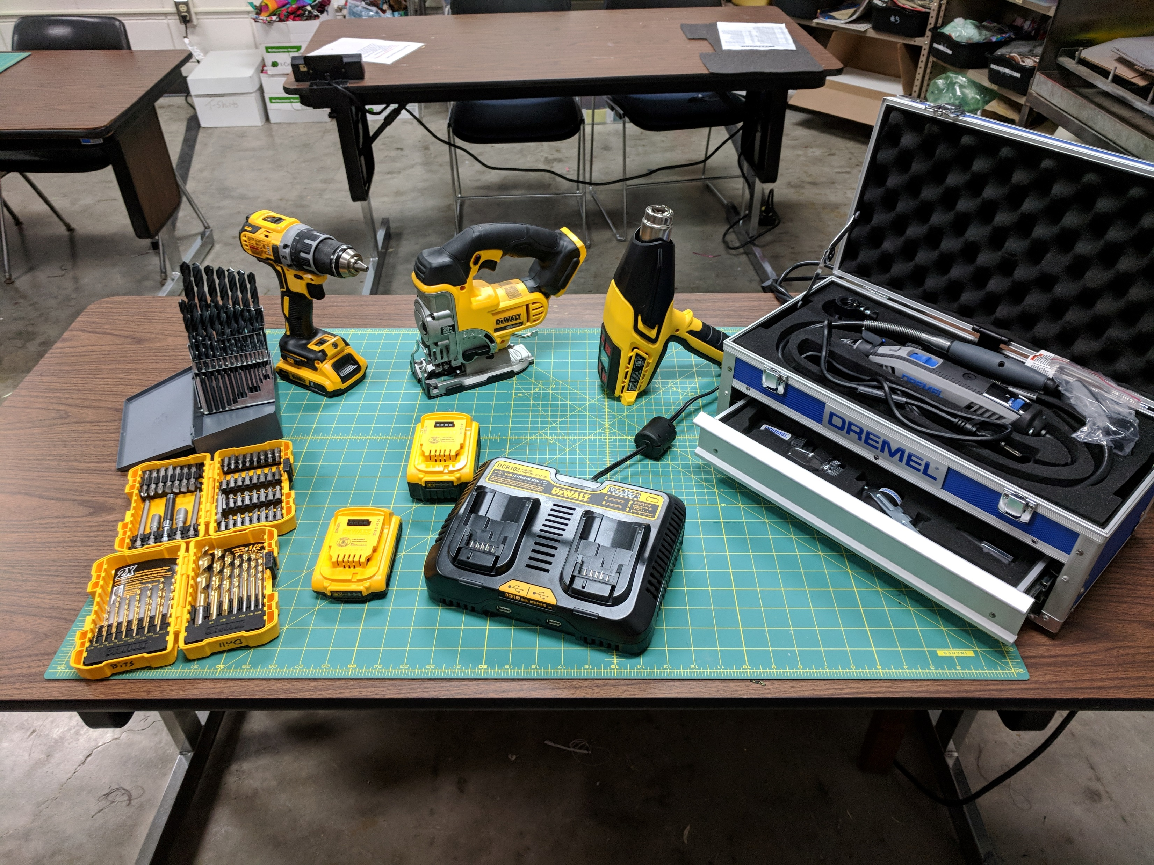

Slide 24
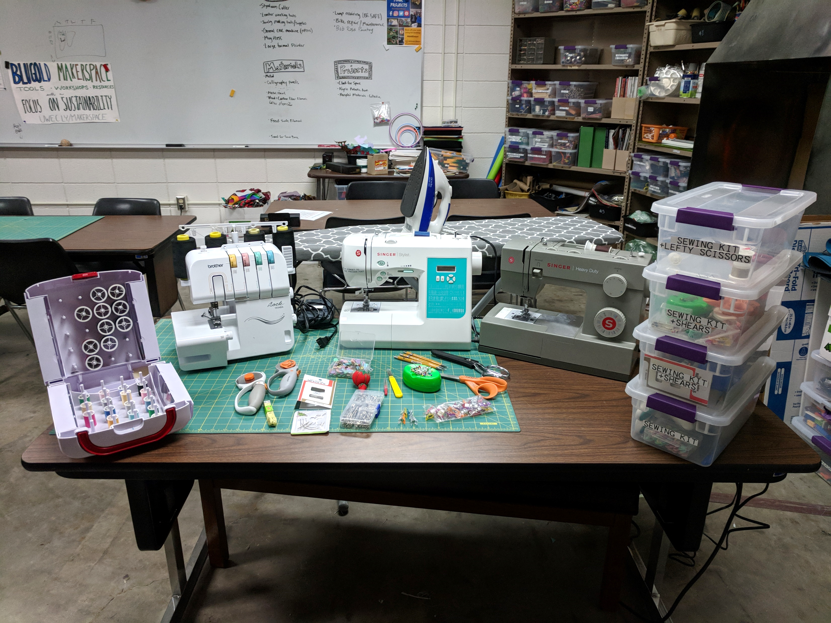

Slide 25
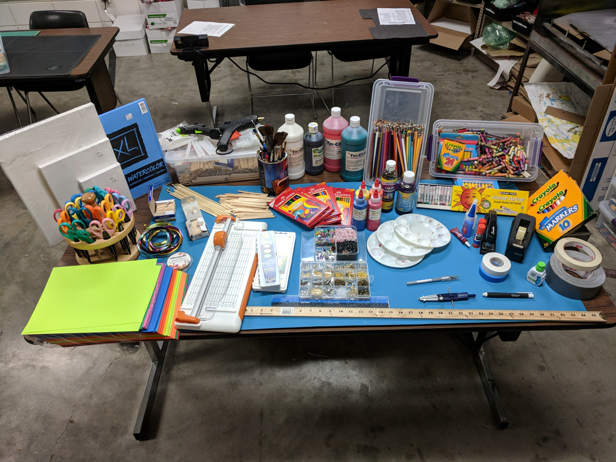

Slide 26
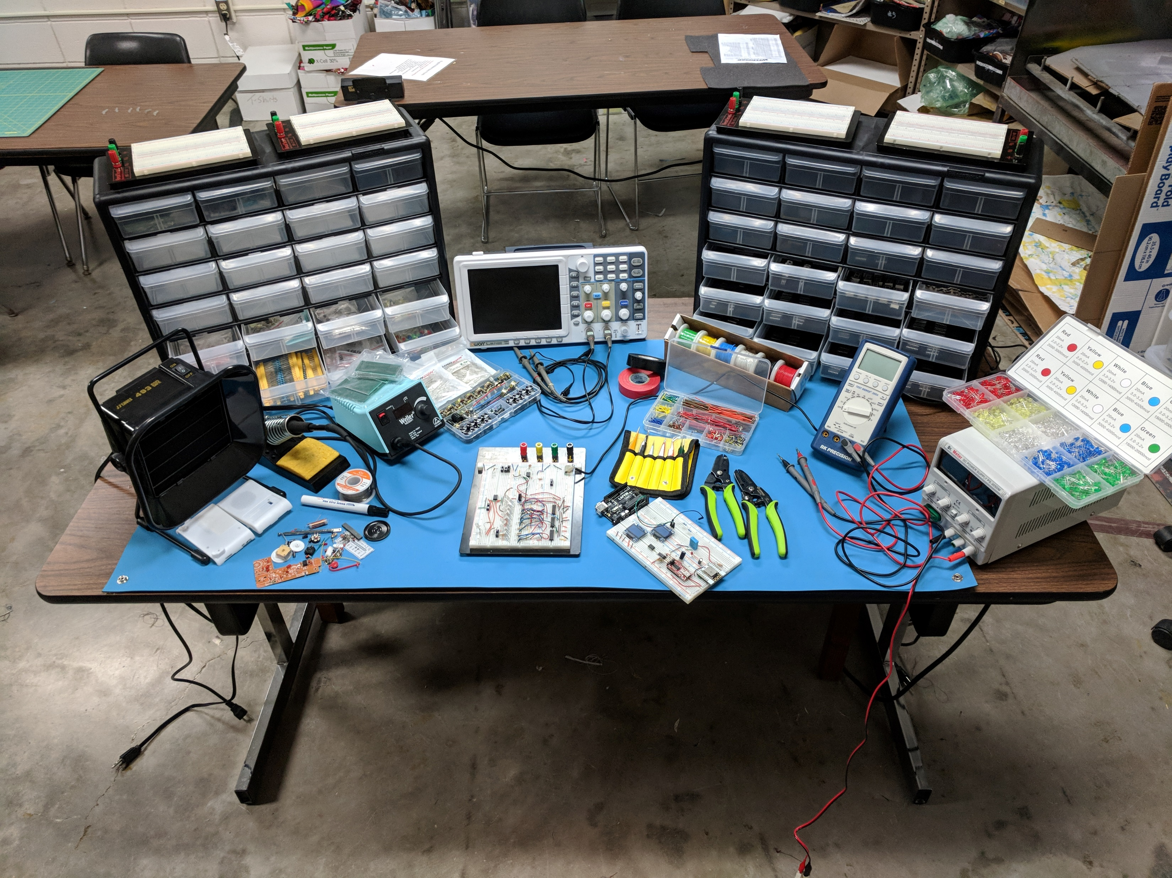

Slide 27
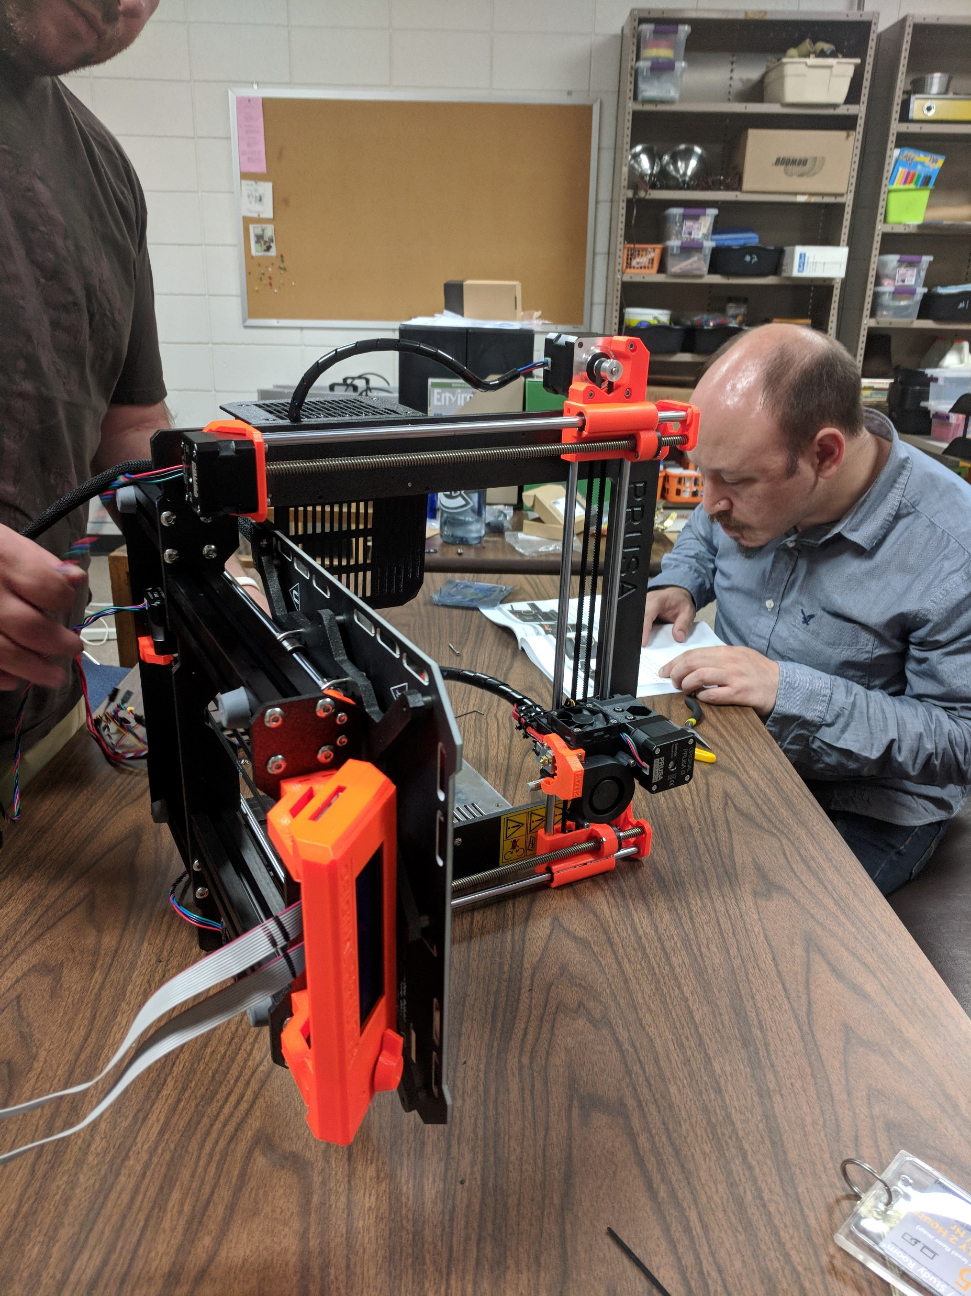
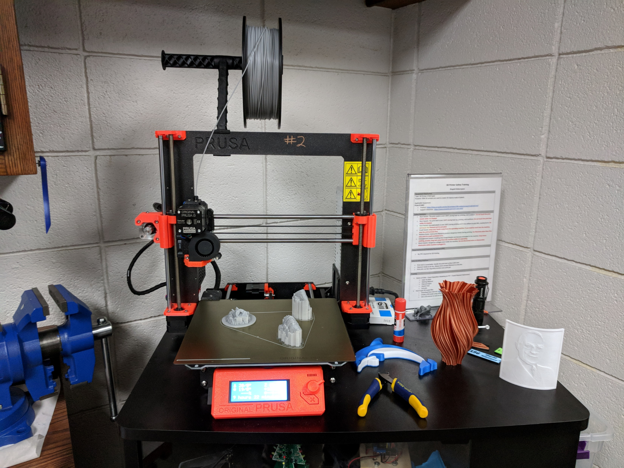

Slide 28
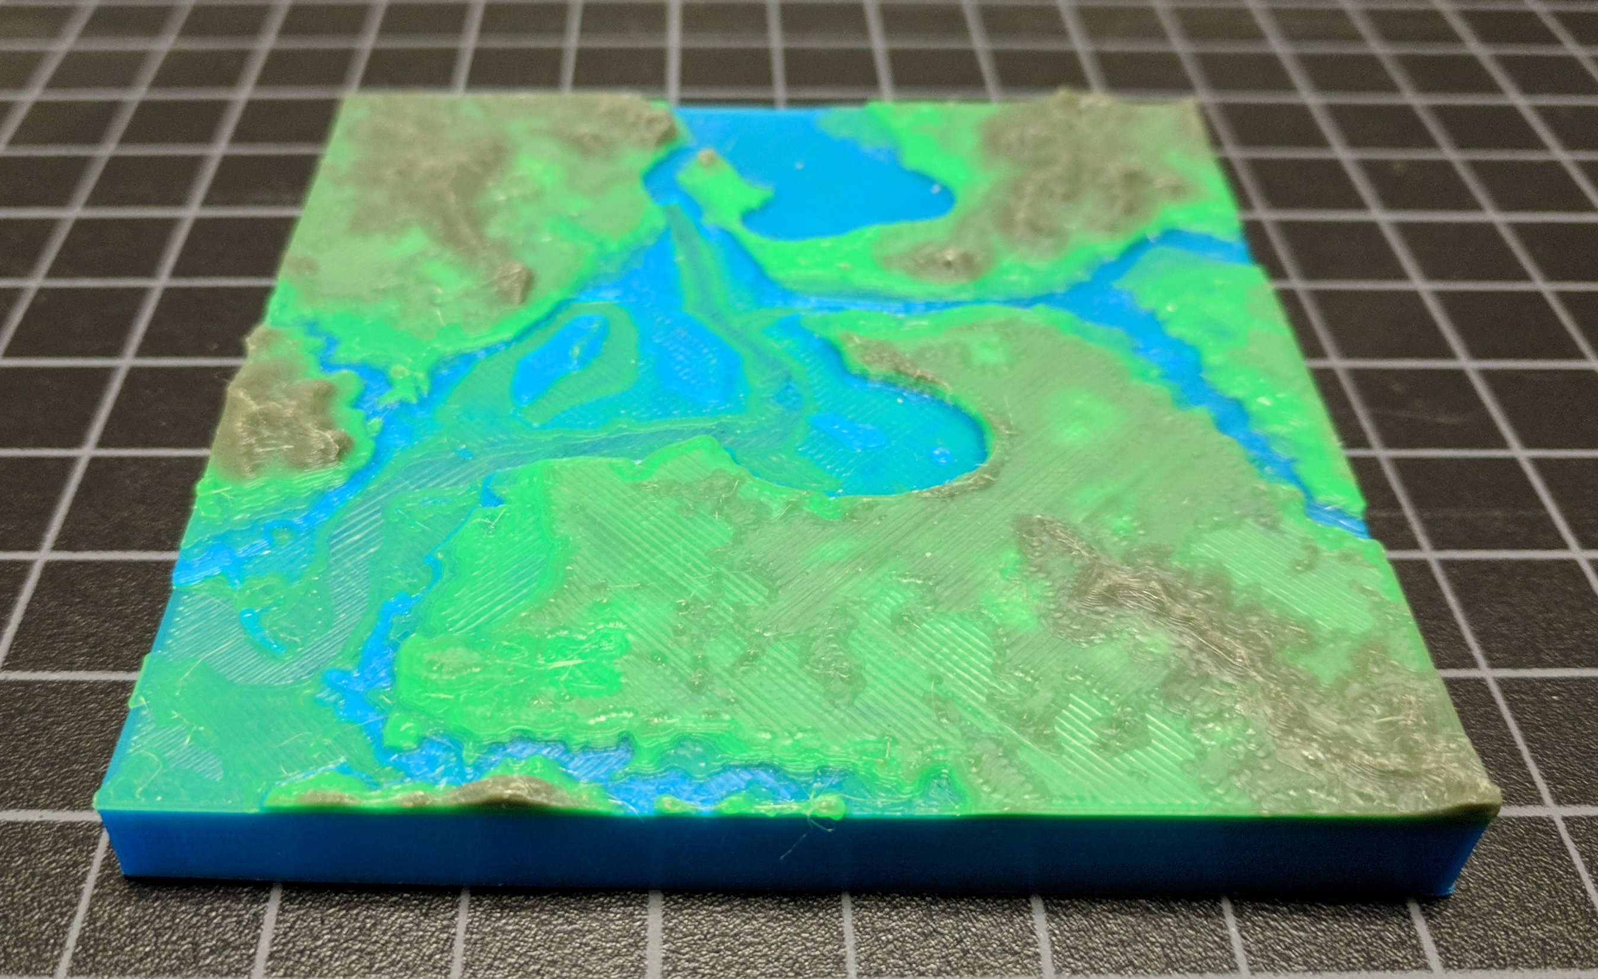

Slide 29
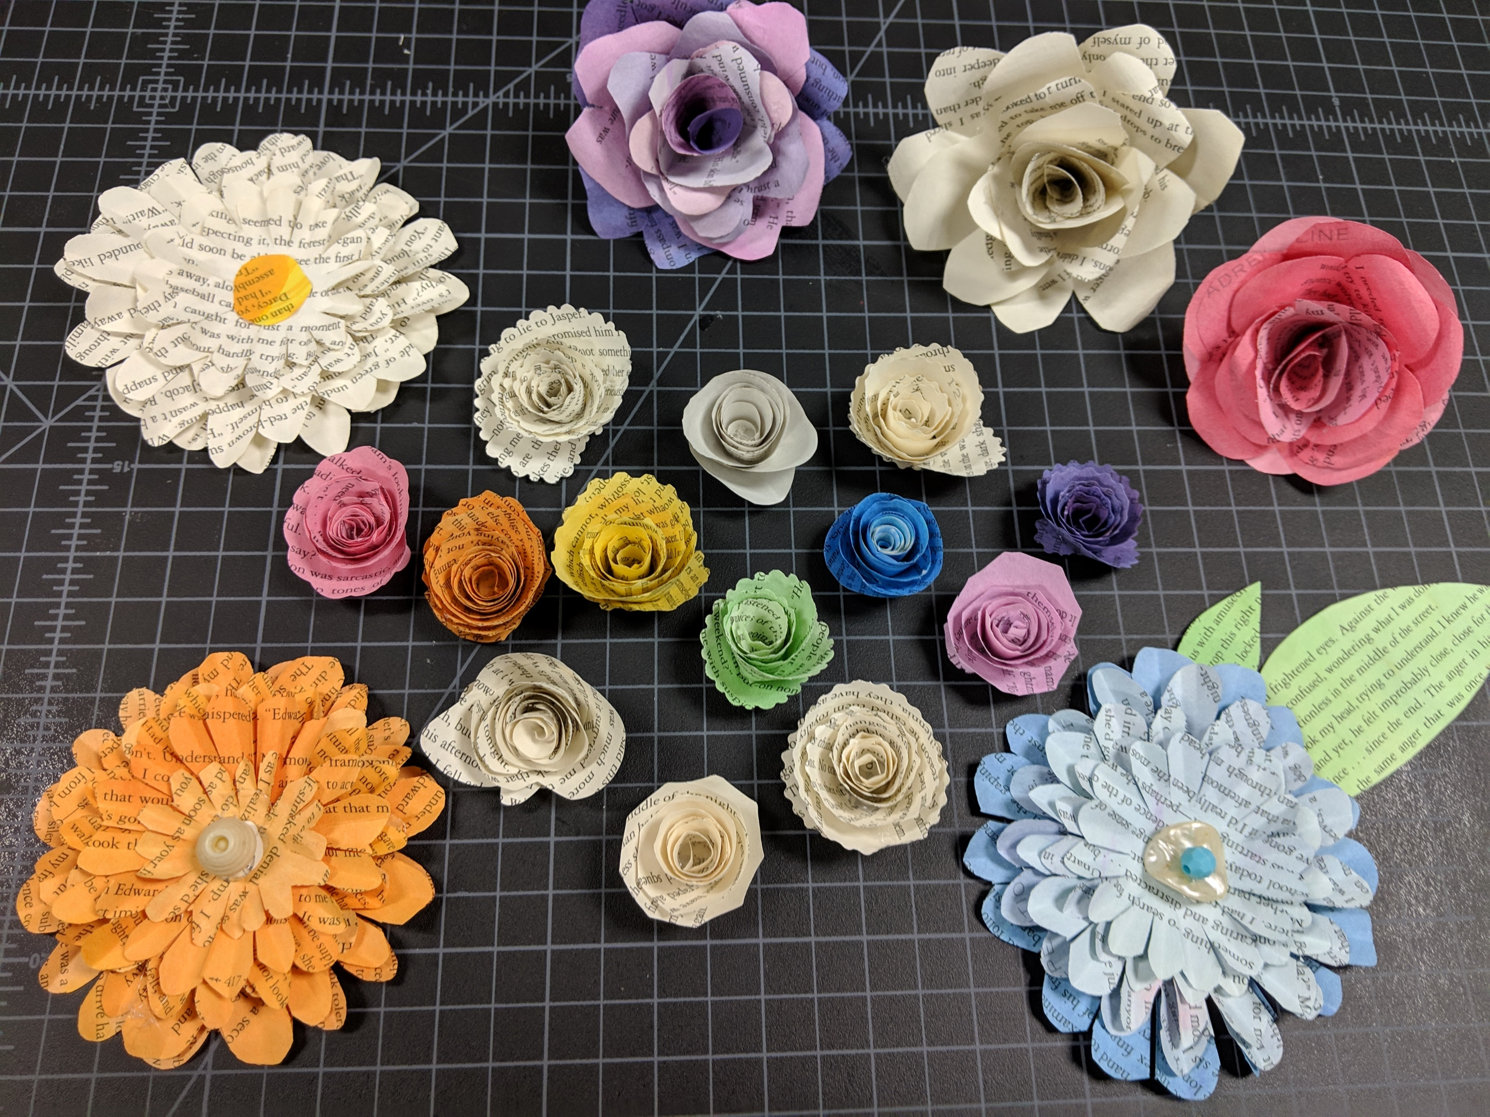

Slide 30
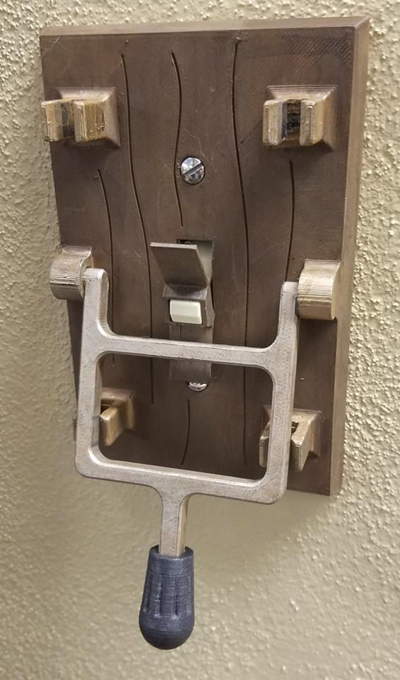
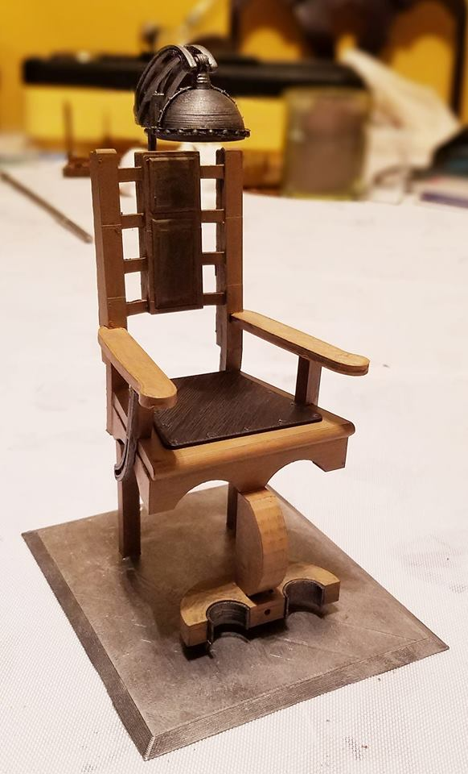

Slide 32
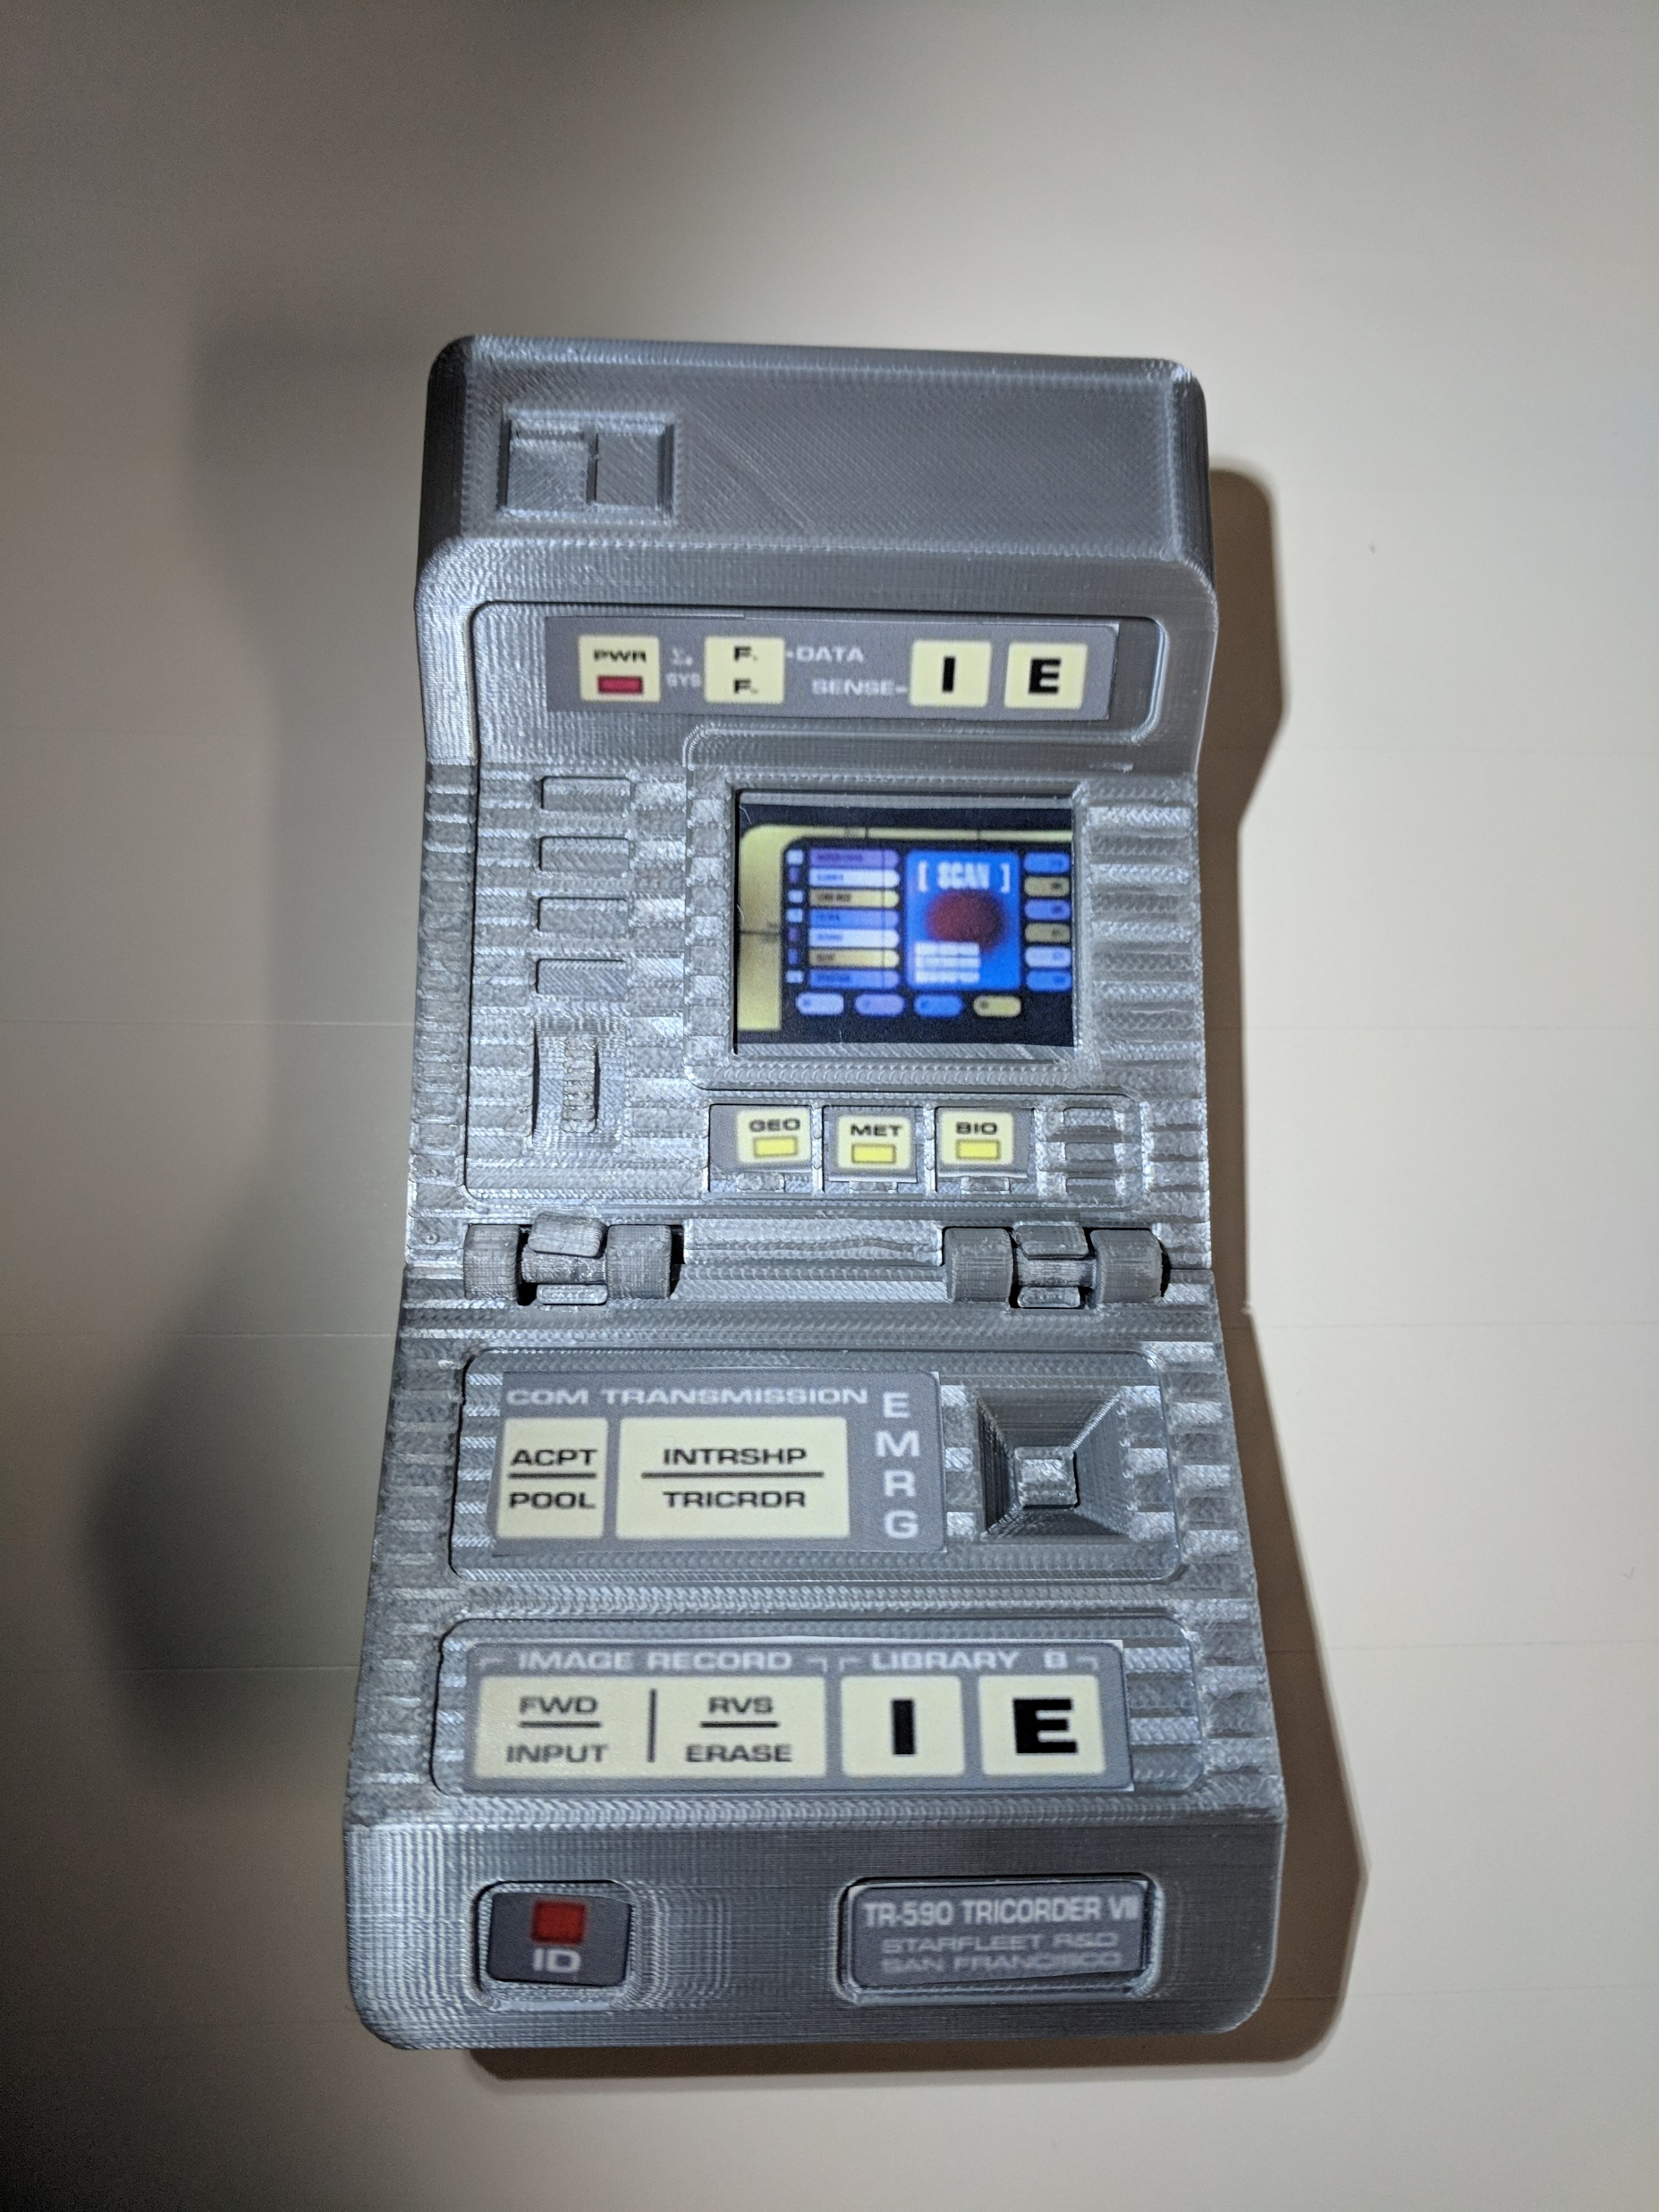
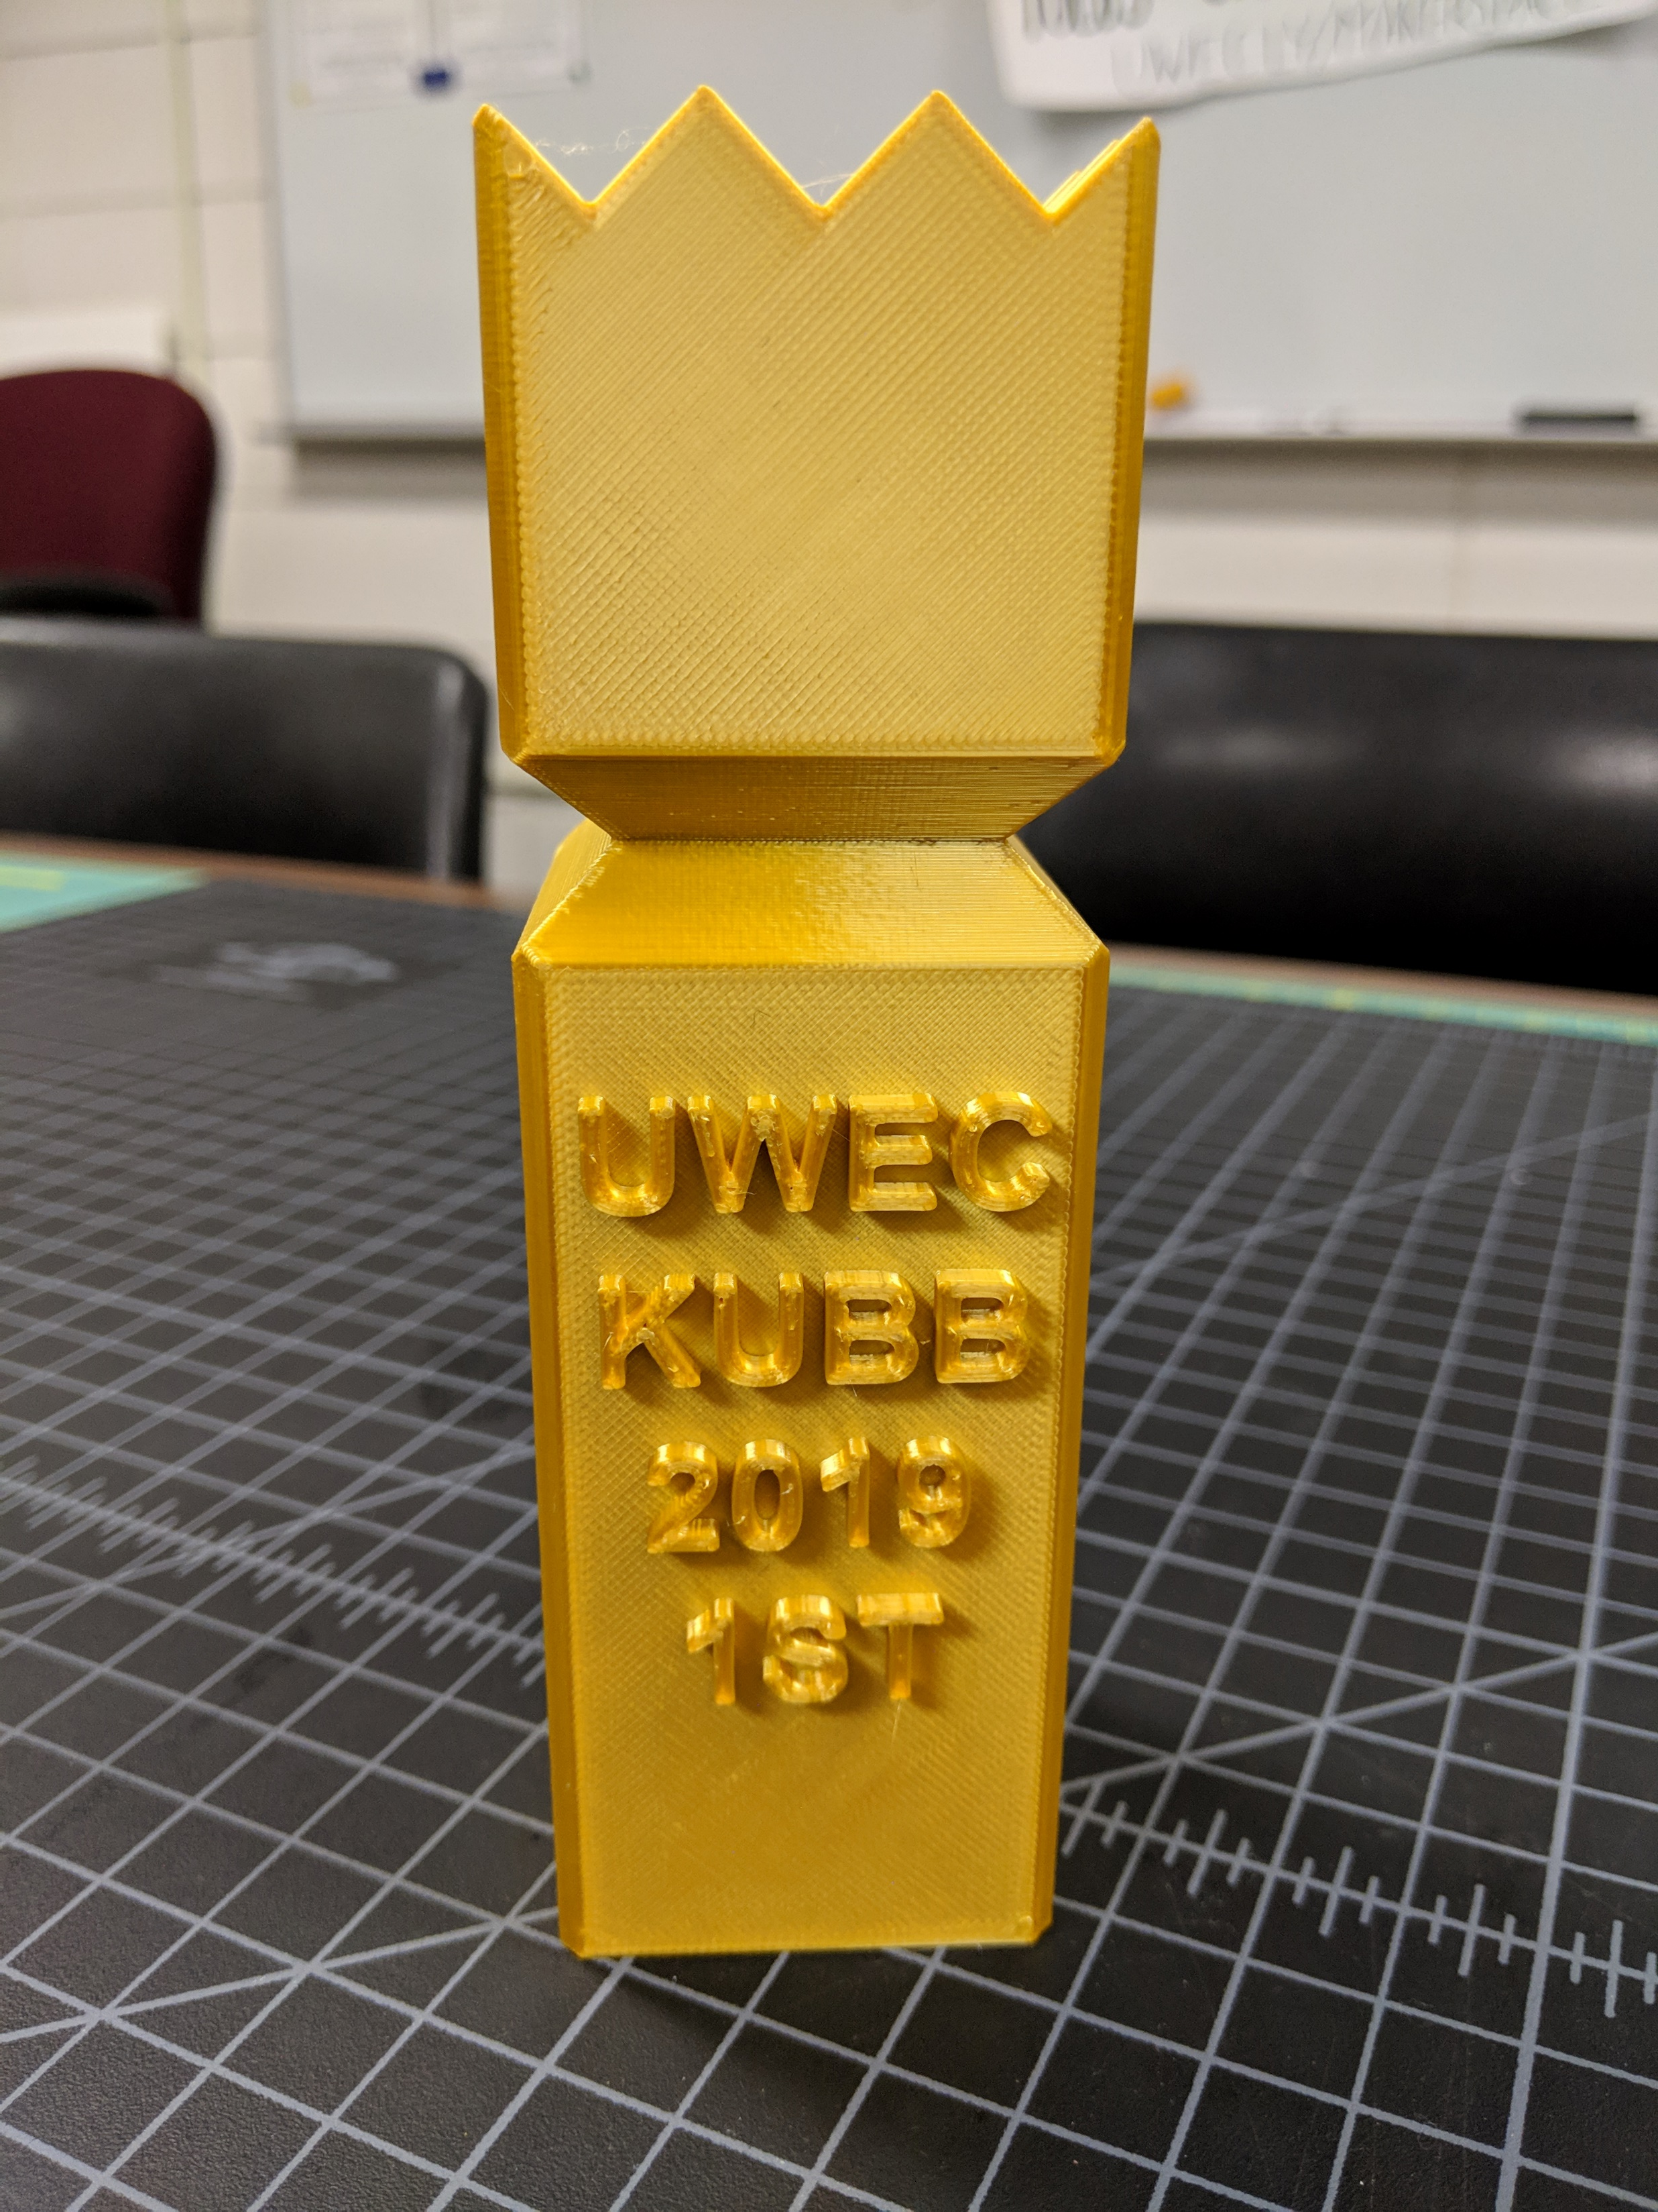

Slide 33
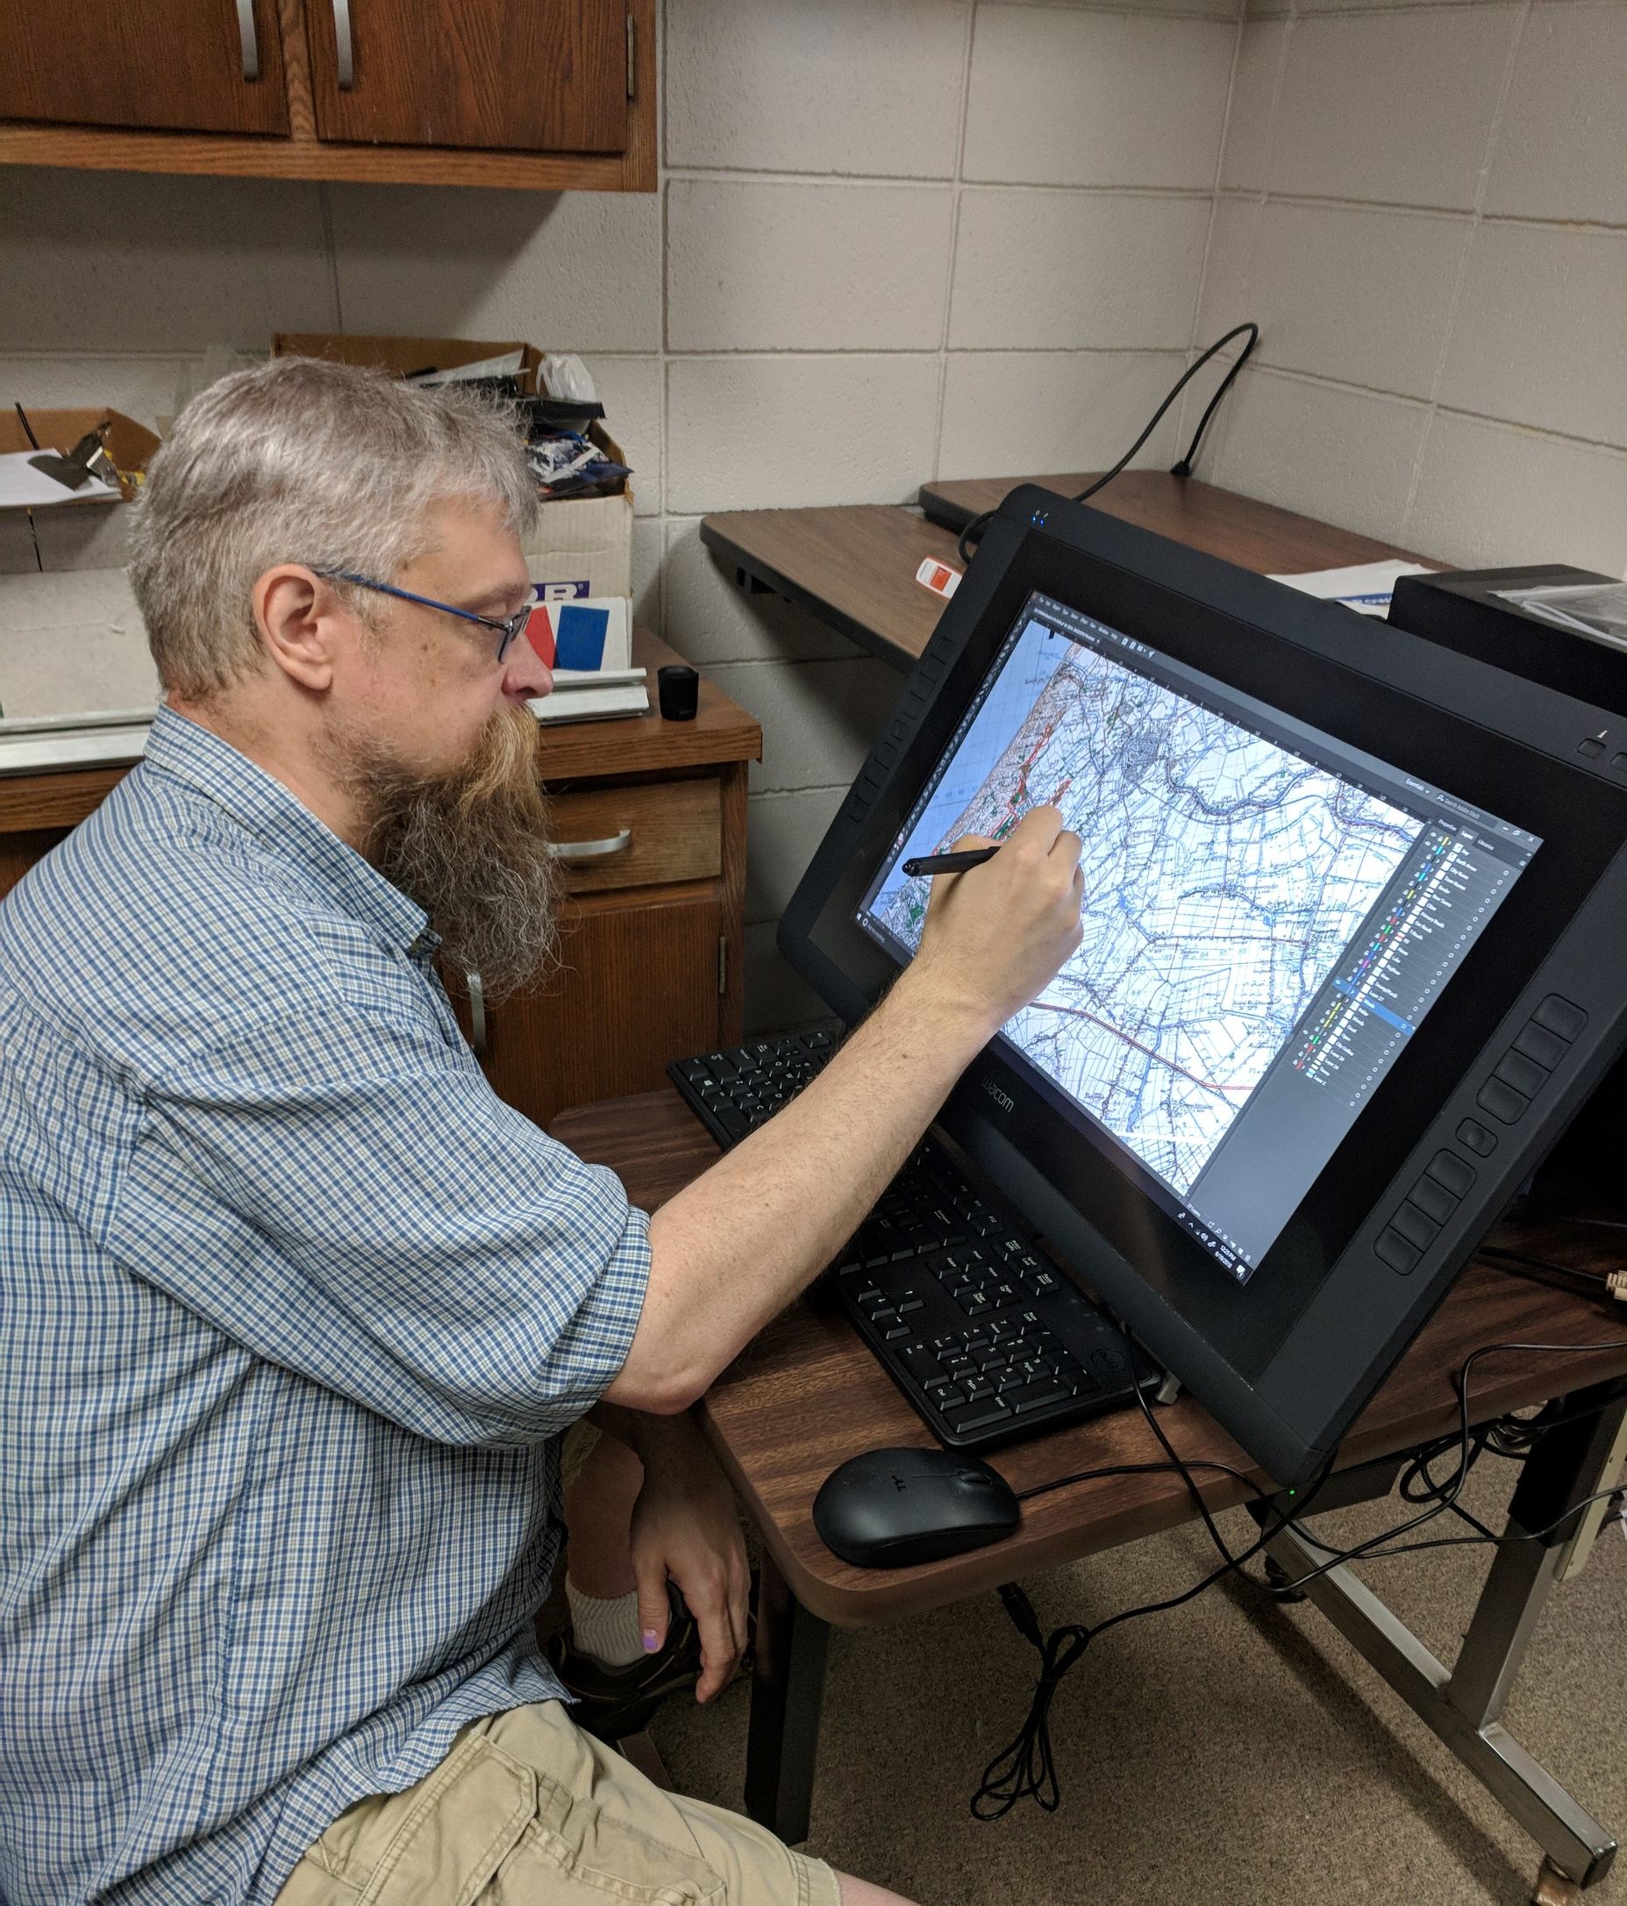
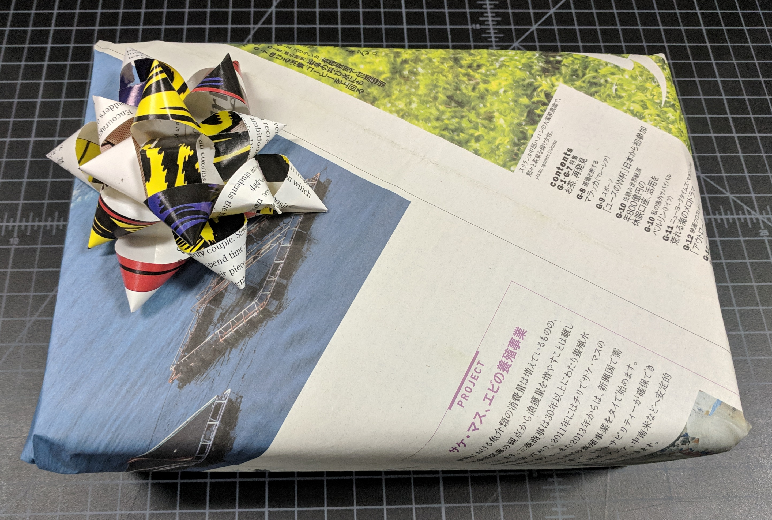

Slide 34
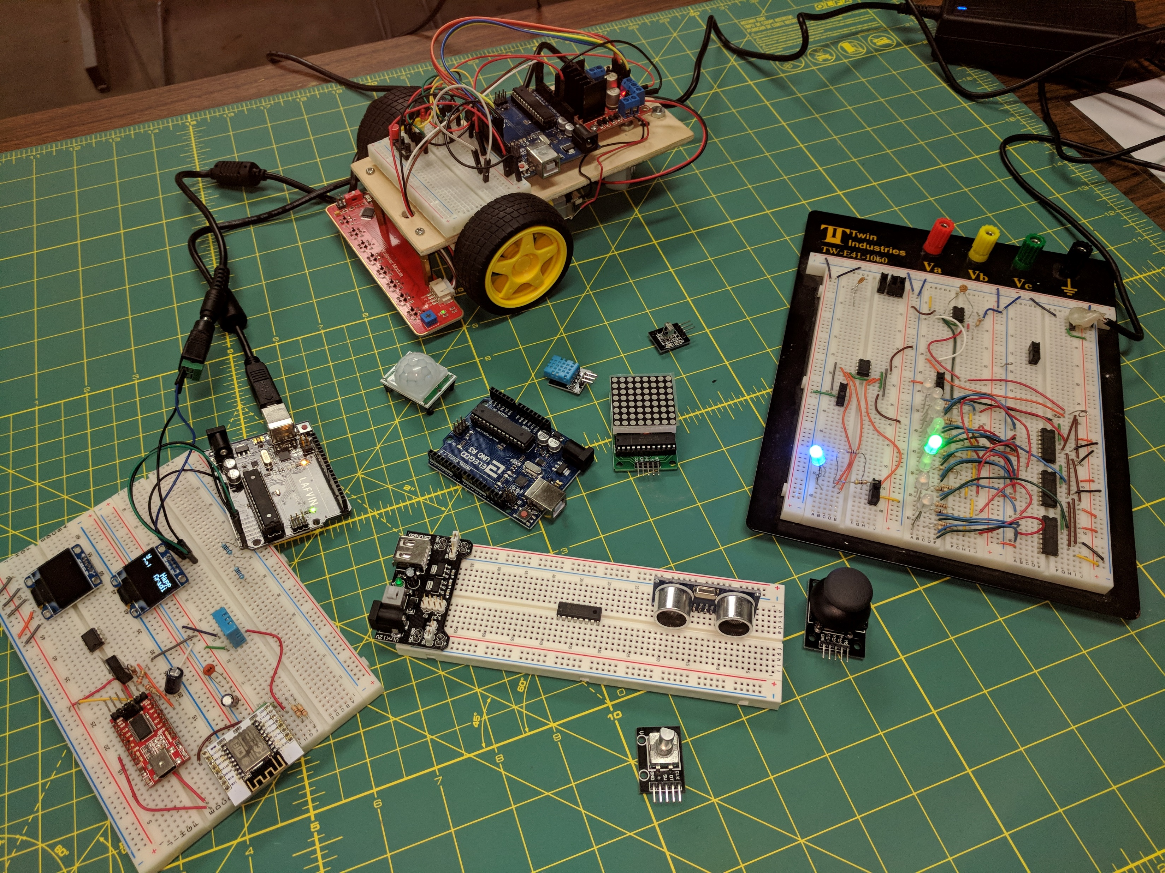

Slide 35
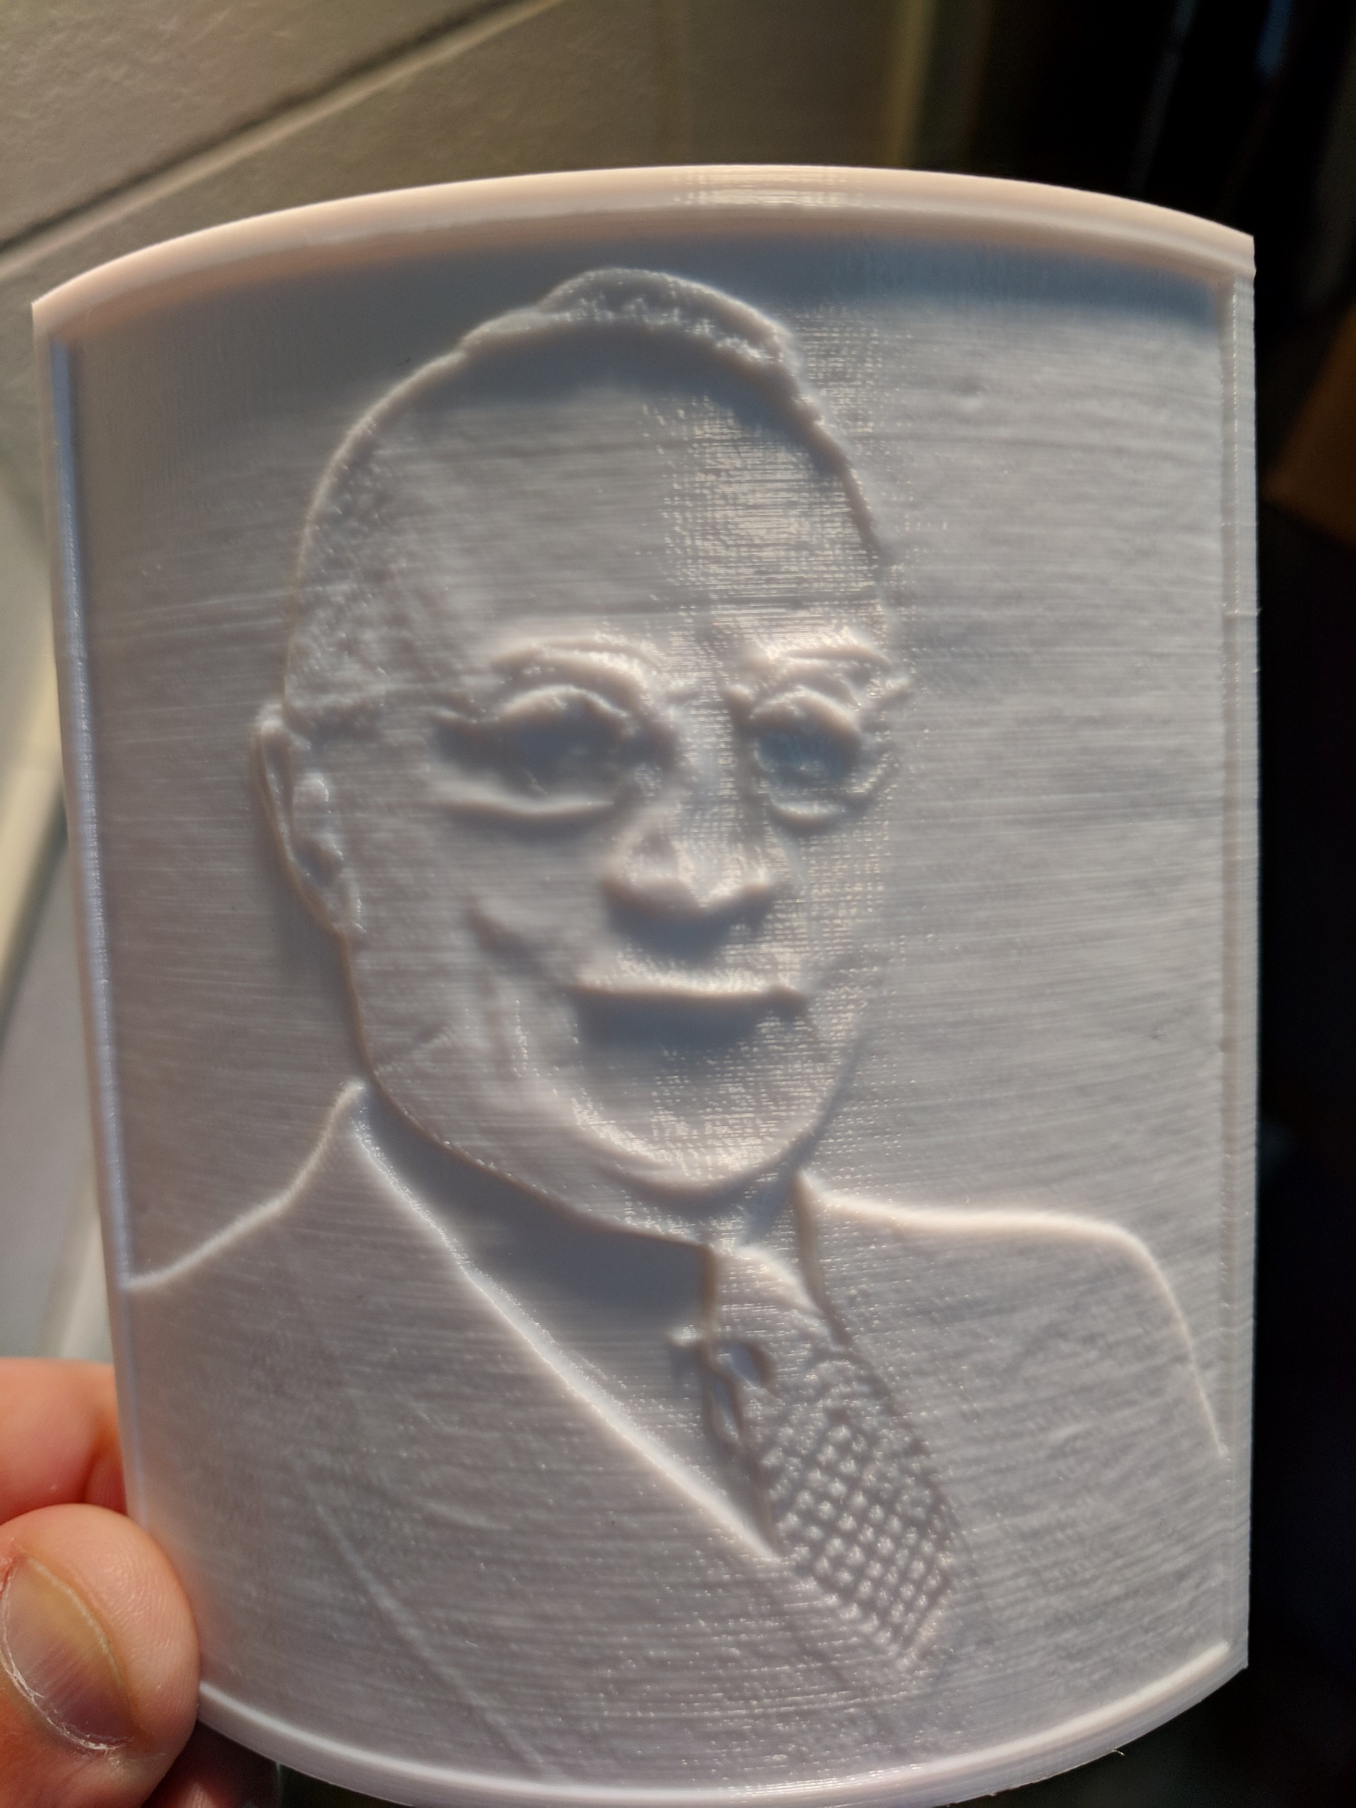
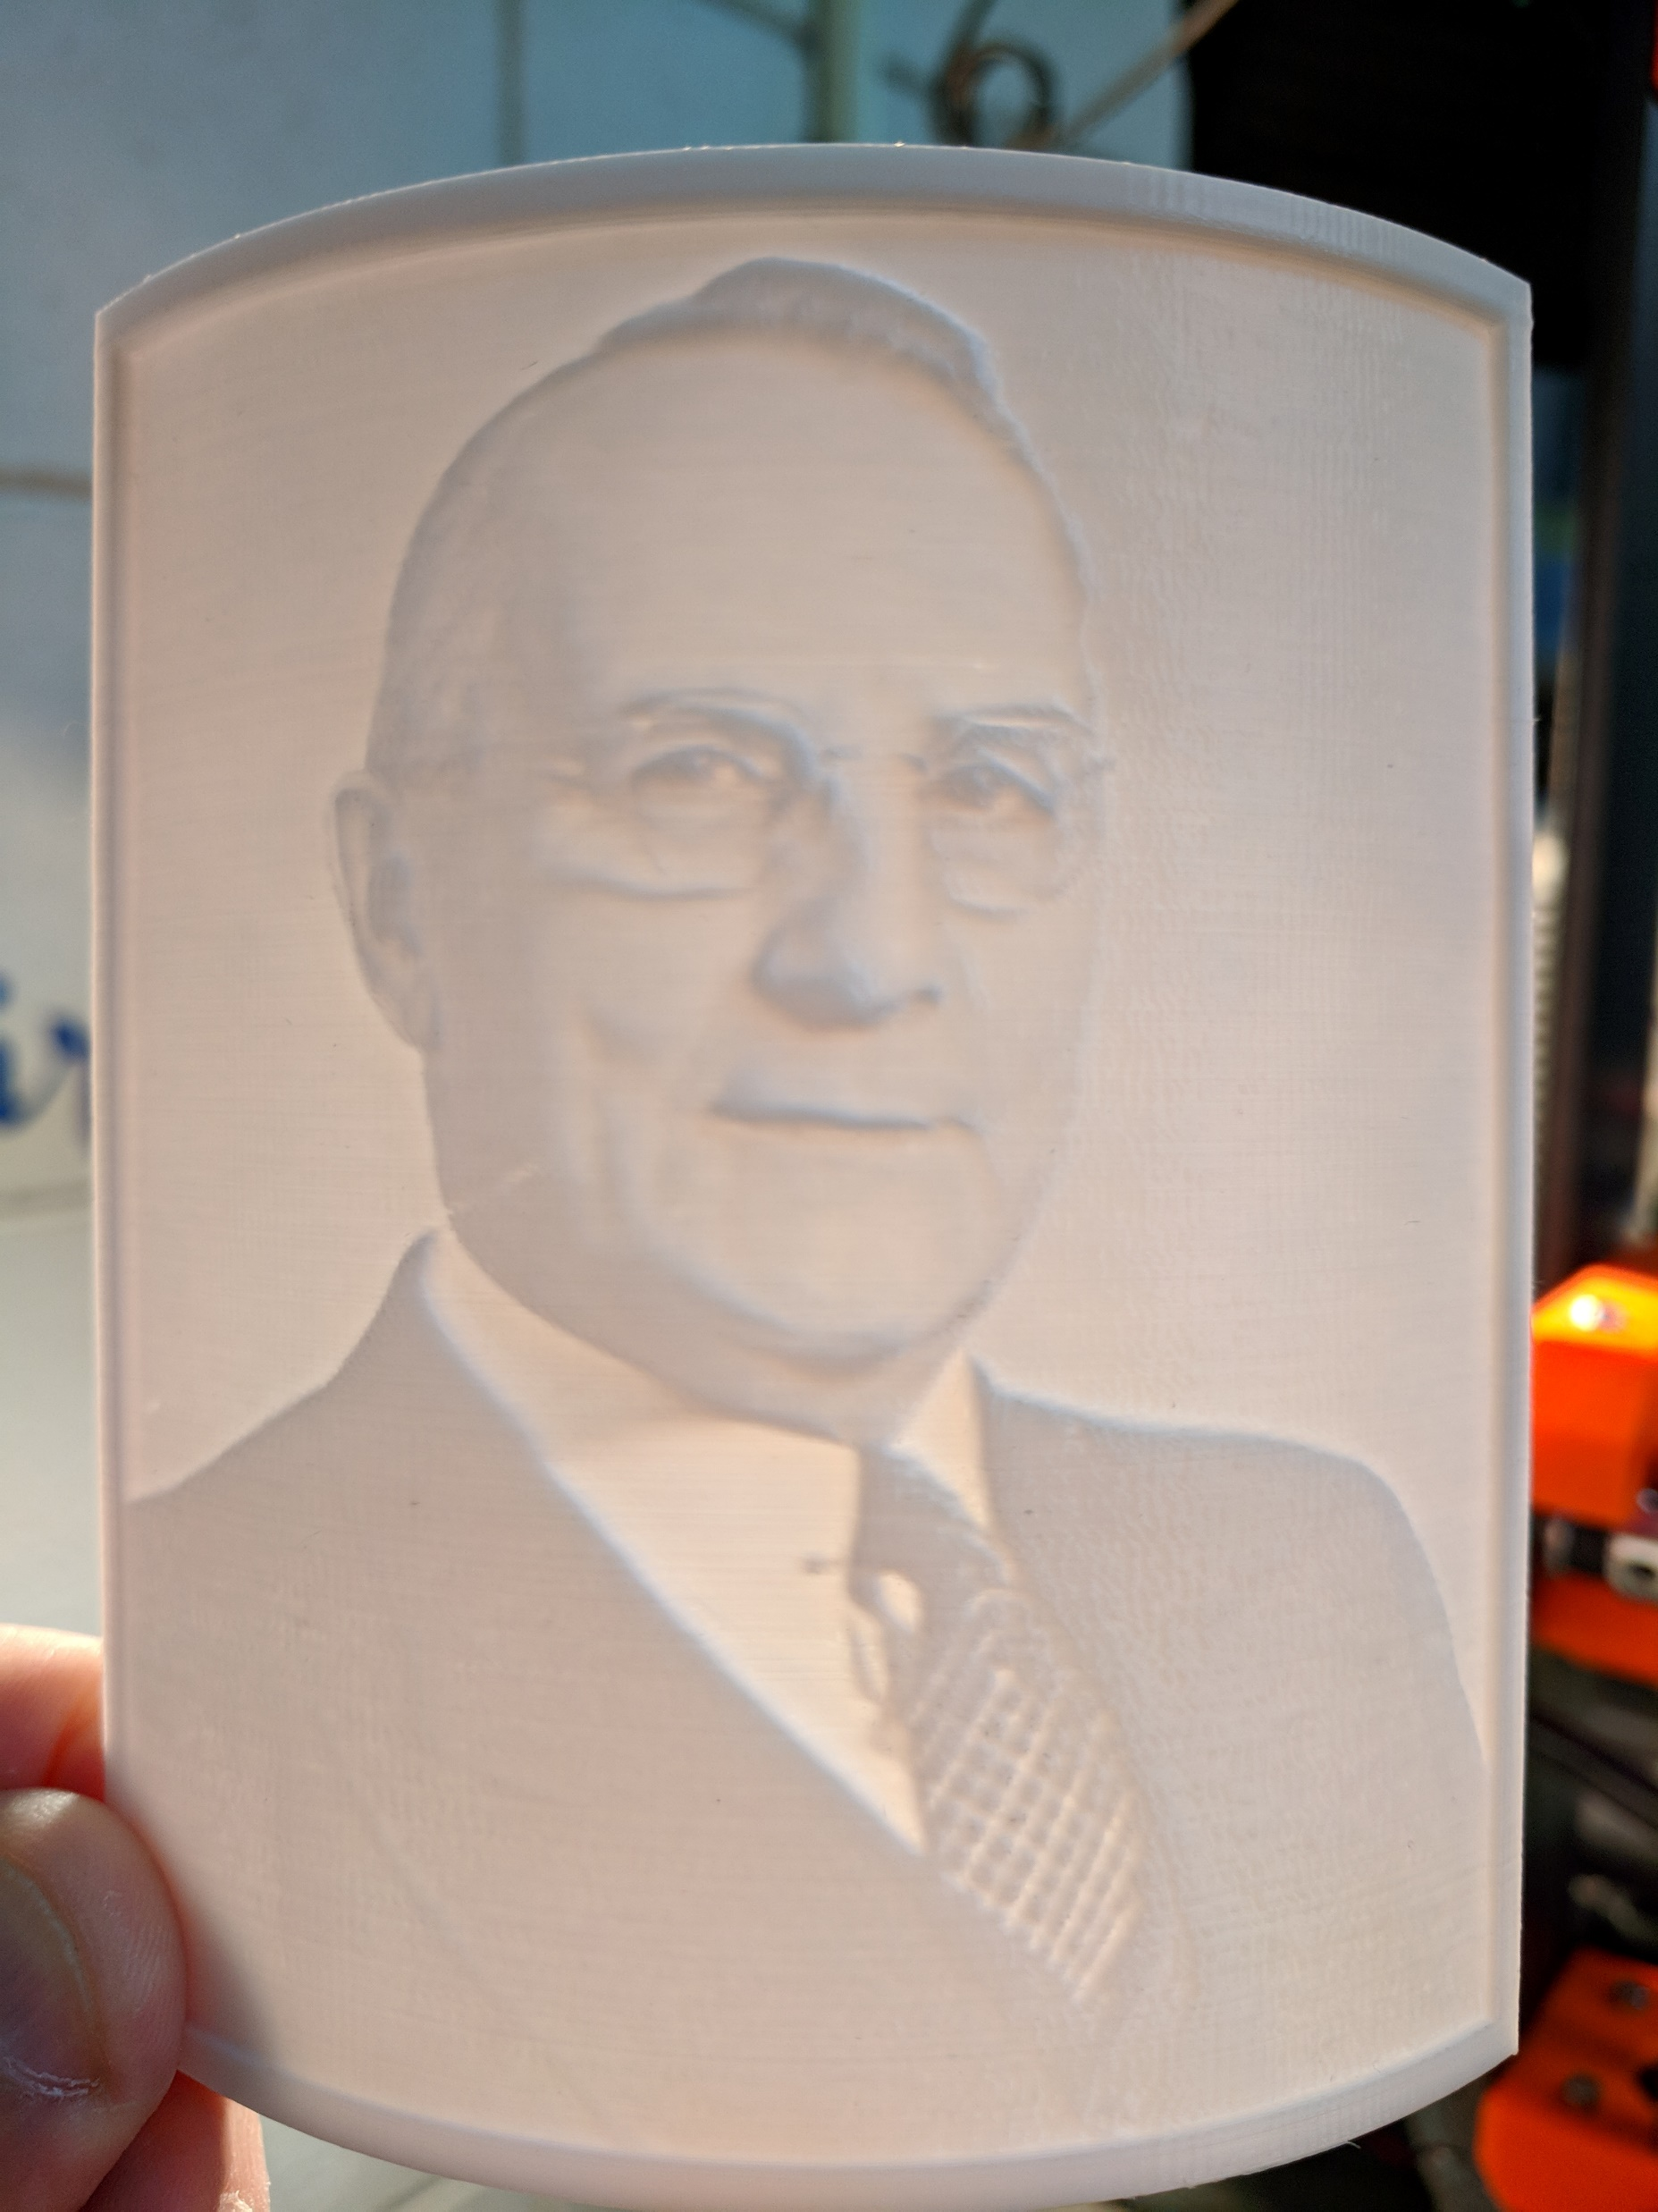
Lithophanes
Justin Bieber
Harvey Schofield – First president of EC State Normal School

Slide 36
Future Plans
Robotics club
Working with faculty/staff
More pointed workshops
Buy a laser cutter
Fill out the website with tools and projects
Digital creation lab

Slide 37
Thank you for your time Questions / Comments
This slideshow and other resources:
http://LIB.UWEC.EDU/Systems/Presentations.aspx
Makerspace webpage:
http://uwec.ly/Makerspace
Dan Hillis
Library Systems and Makerspace Coordinator
McIntyre Library
UW-Eau Claire
HILLISDR@UWEC.EDU

